Slide 1














Slide 2

Table of Content
01. Introduction
02. Fundamentals
03. Layout and Compositions
04. Tools and Software
05. Conclusion

Slide 3

Graphic design is an art – an expression of one’s aesthetic.
-van gogh

Slide 4
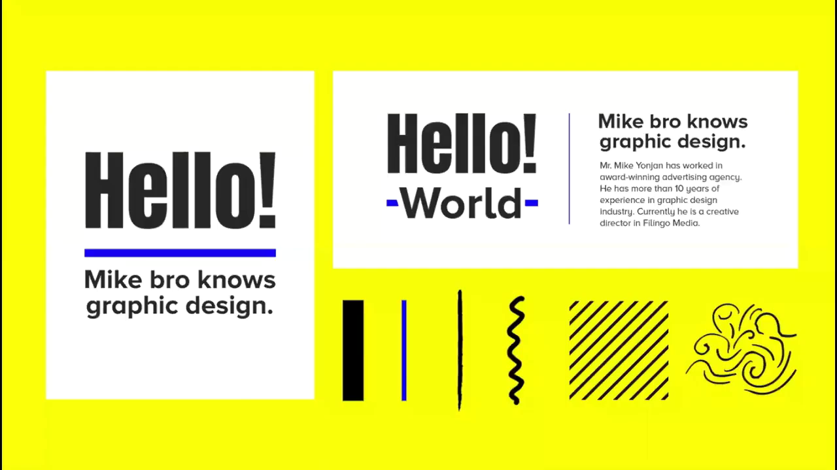
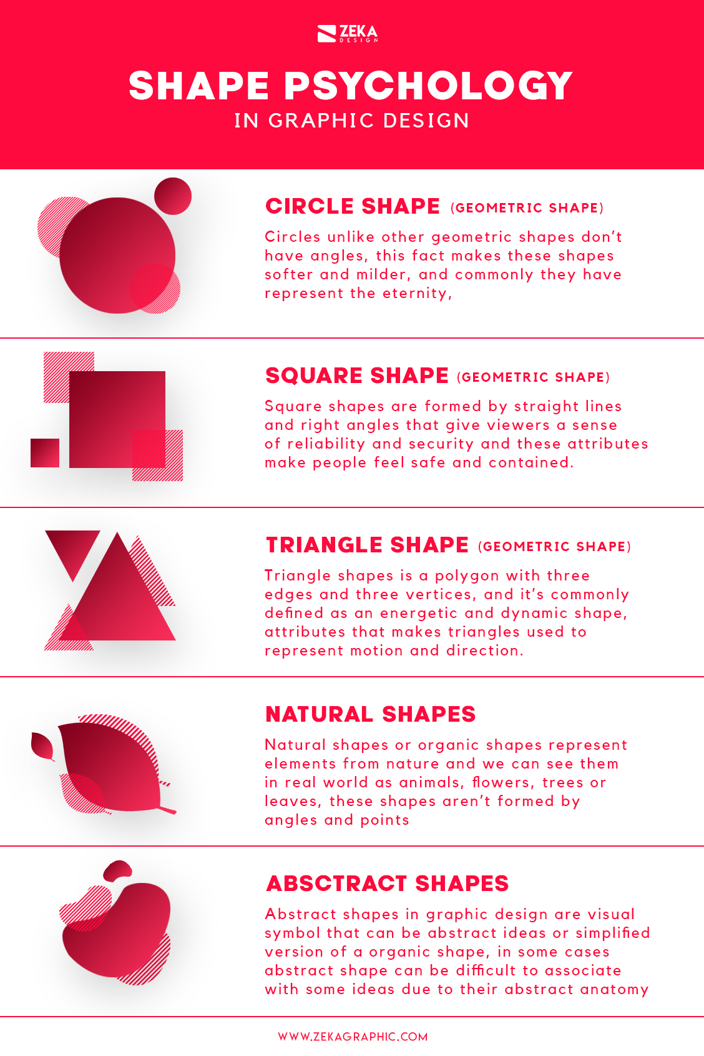
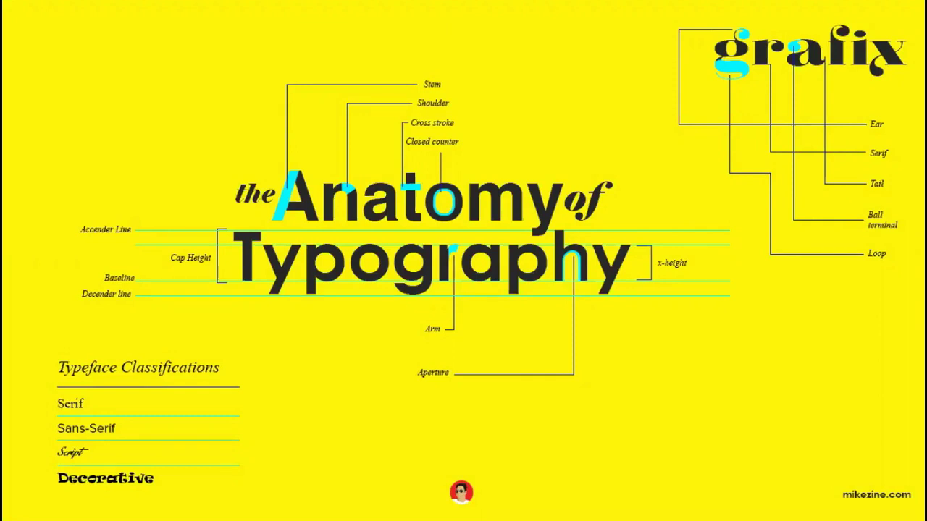
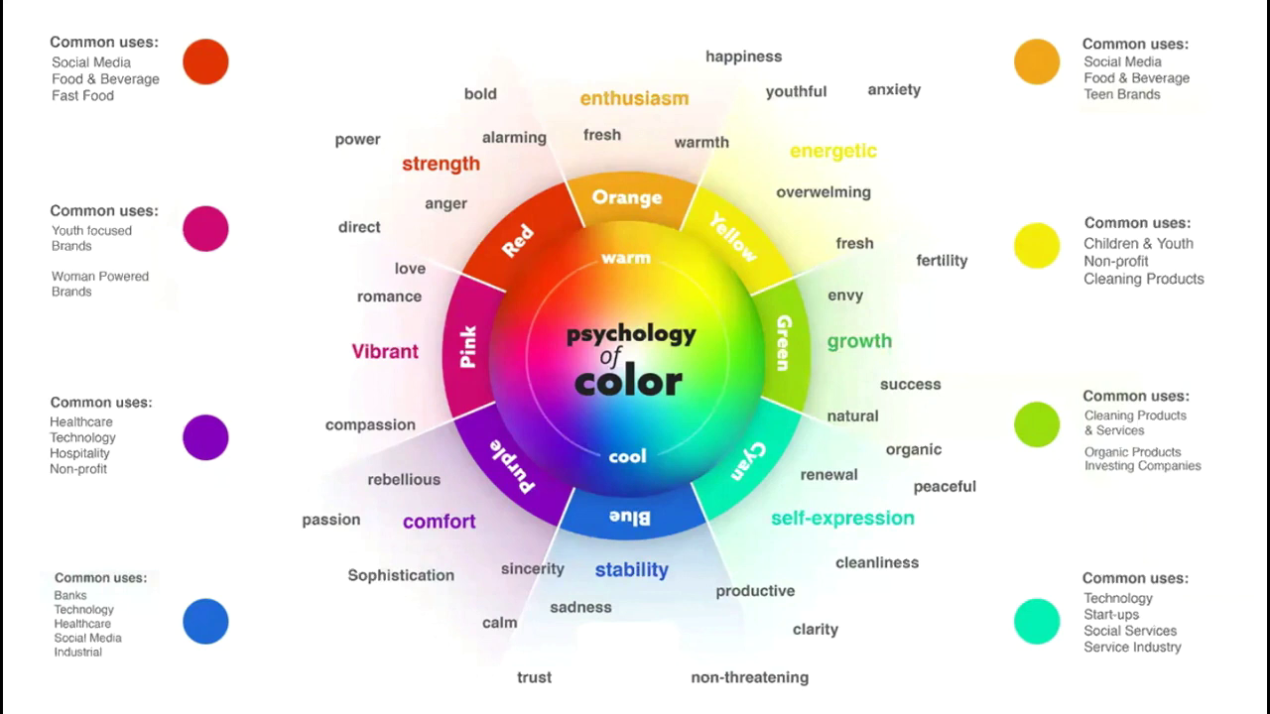
of Graphic Design
Fundamental |
Elements
Line
Shape
Typography
Colors

Slide 5
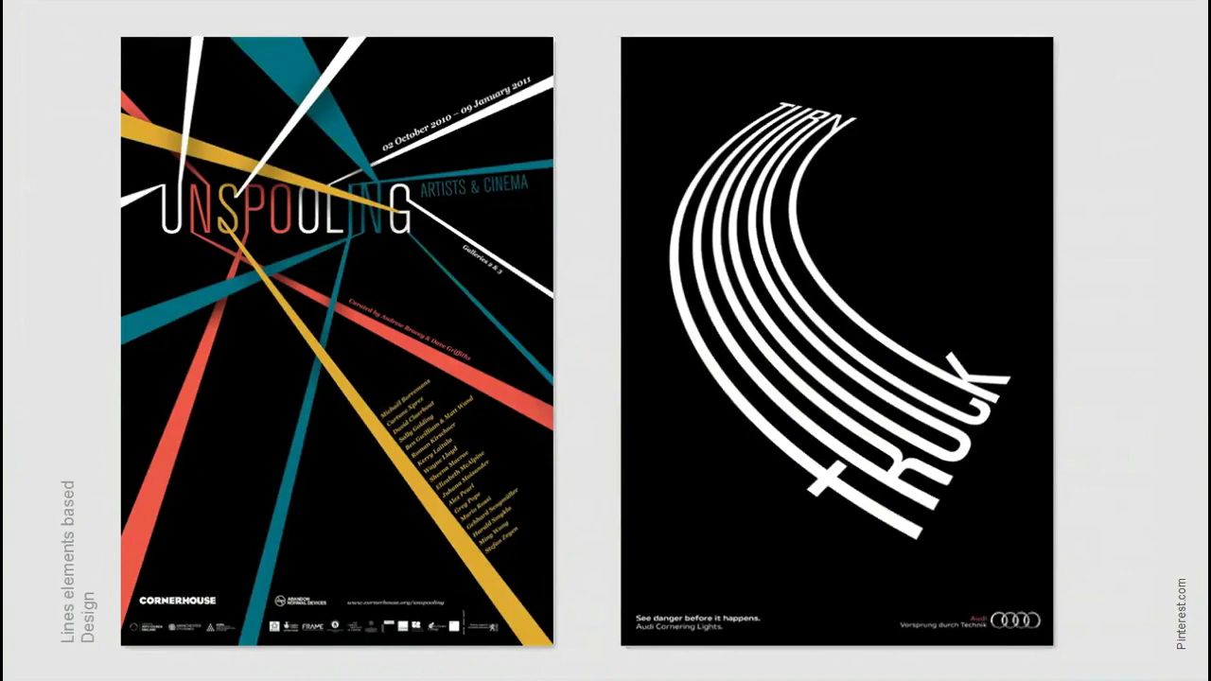
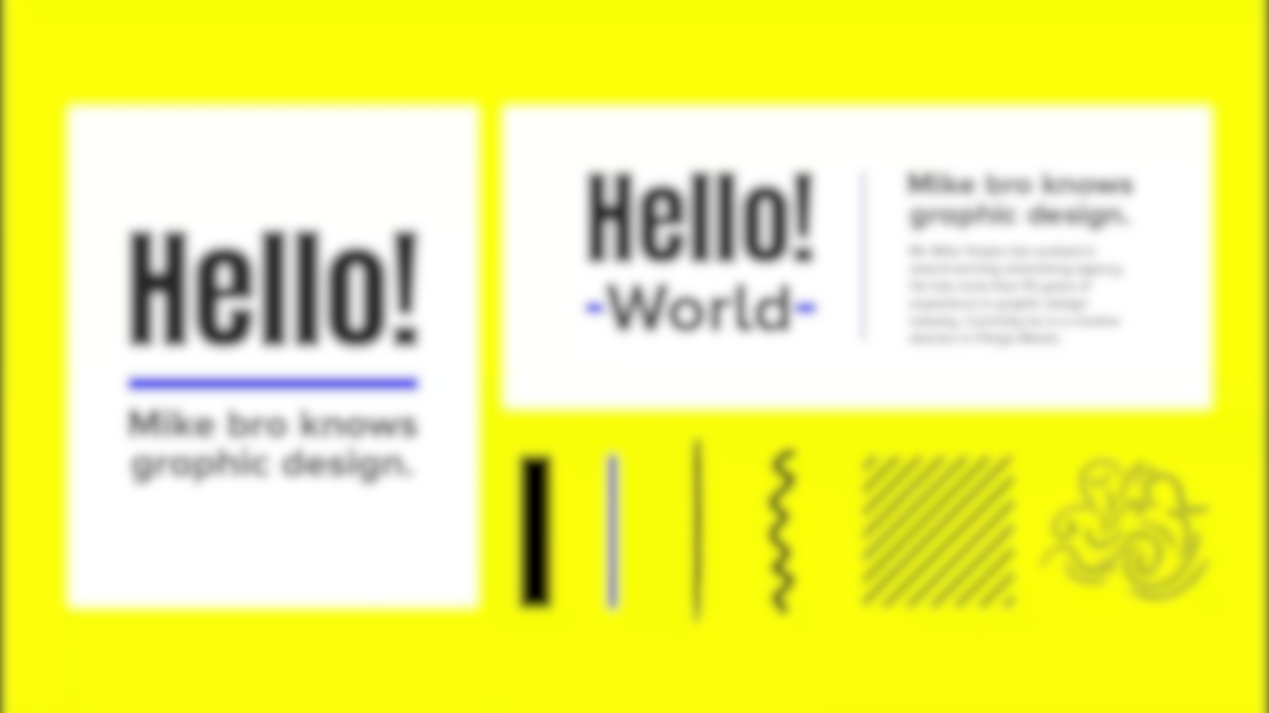
Elements
Line
Shape
Typography
Colors

Slide 6
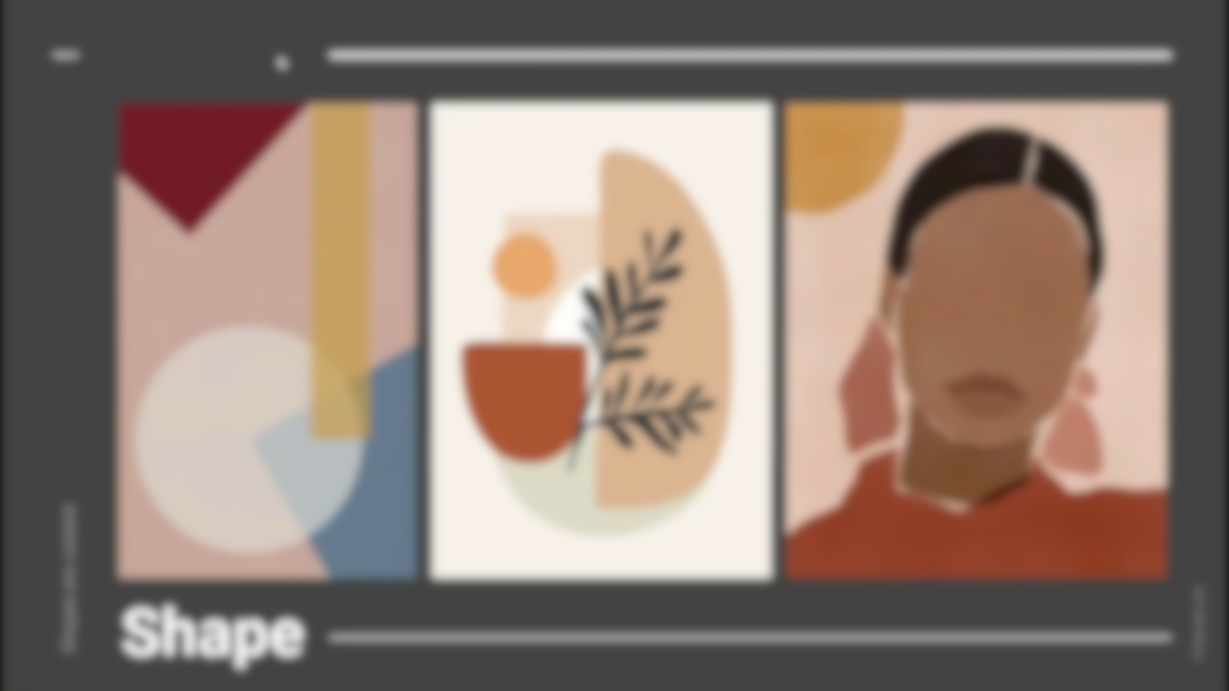
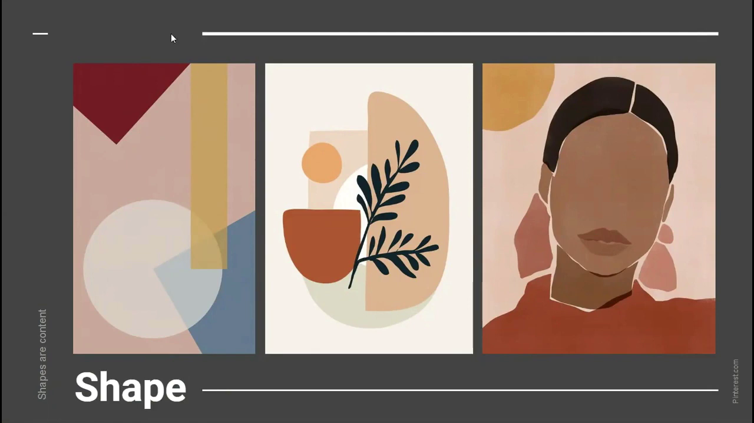
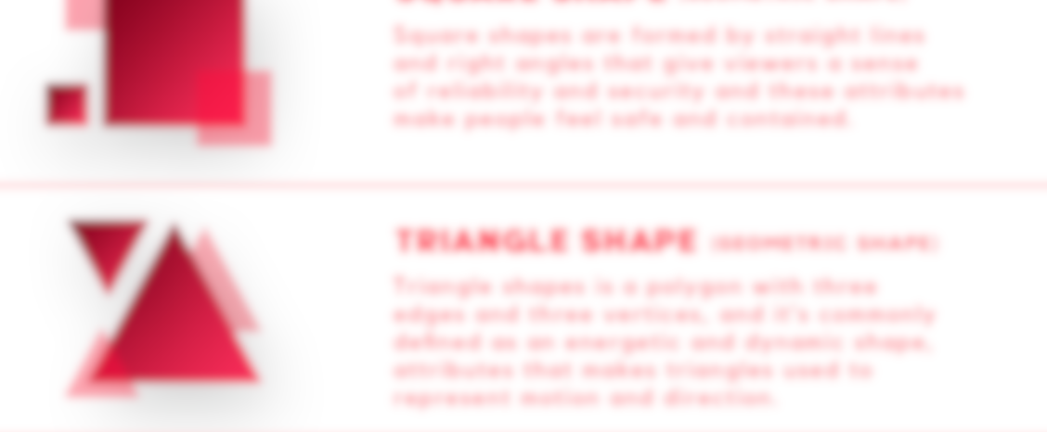
Elements
Line
Shape
Typography
Colors

Slide 7
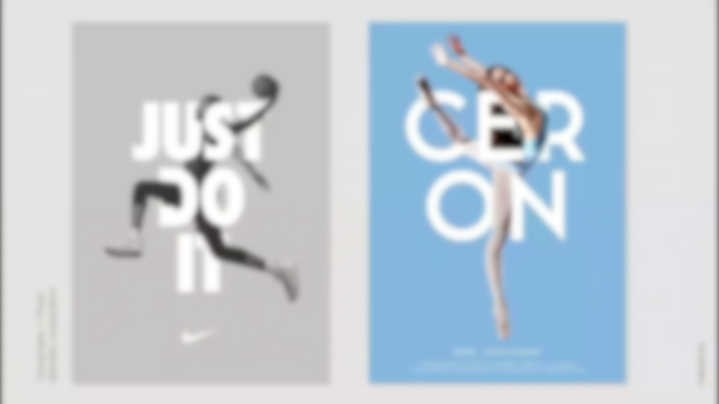
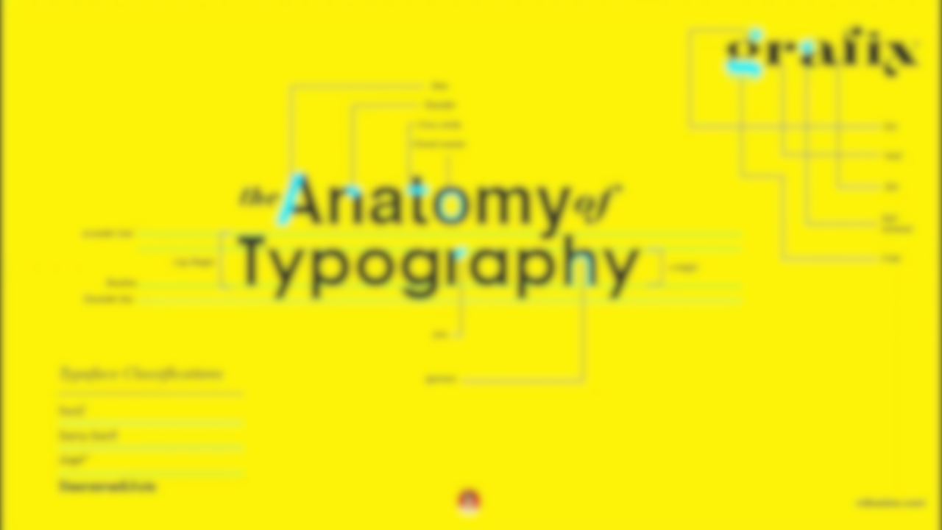
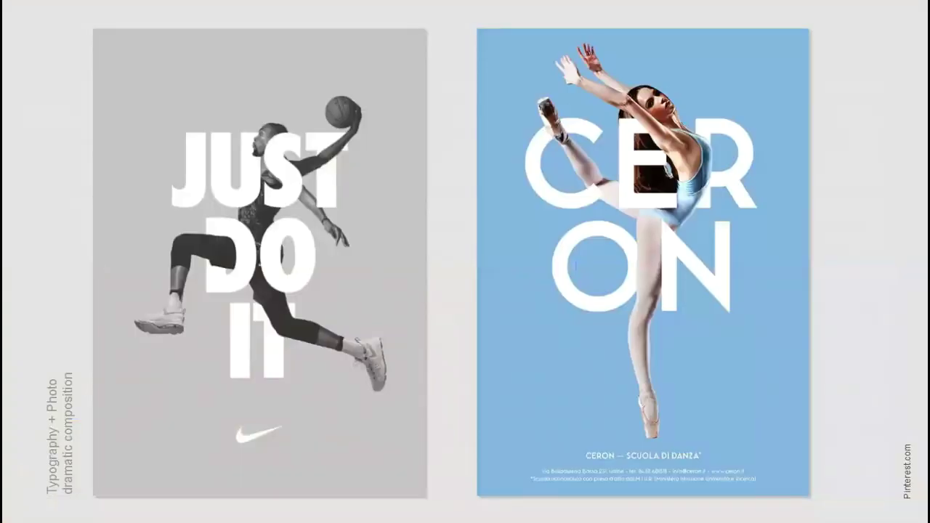
Elements
Typography + Photo
Dramatic composition
Shape
Typography
Colors

Slide 8
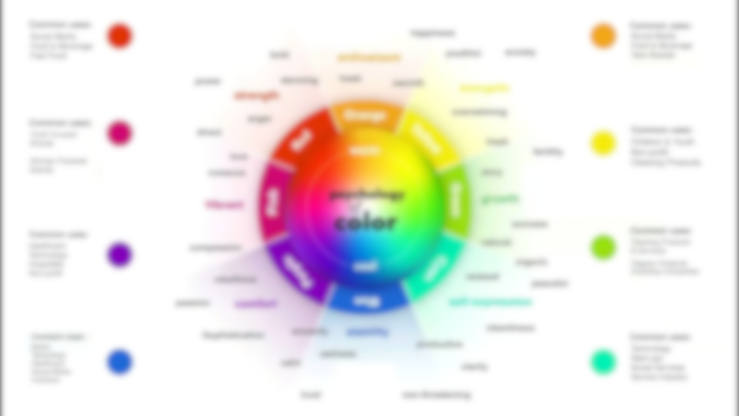
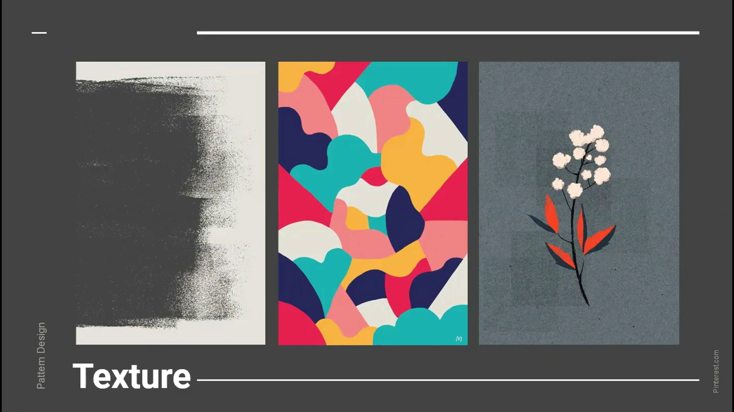
Elements
Typography + Photo
Dramatic composition
Typography
Colors
Texture

Slide 9

Elements
Pattern Design
Colors
Texture

Slide 10
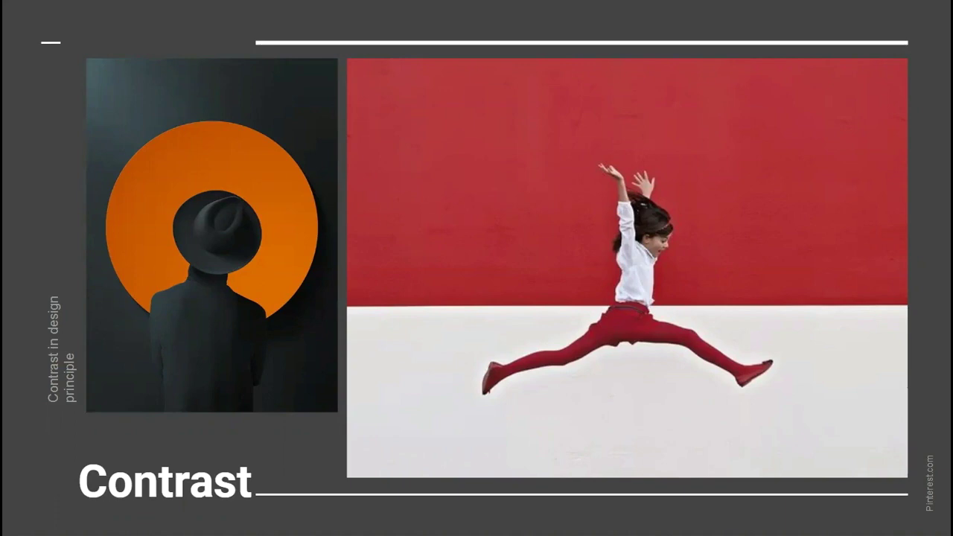
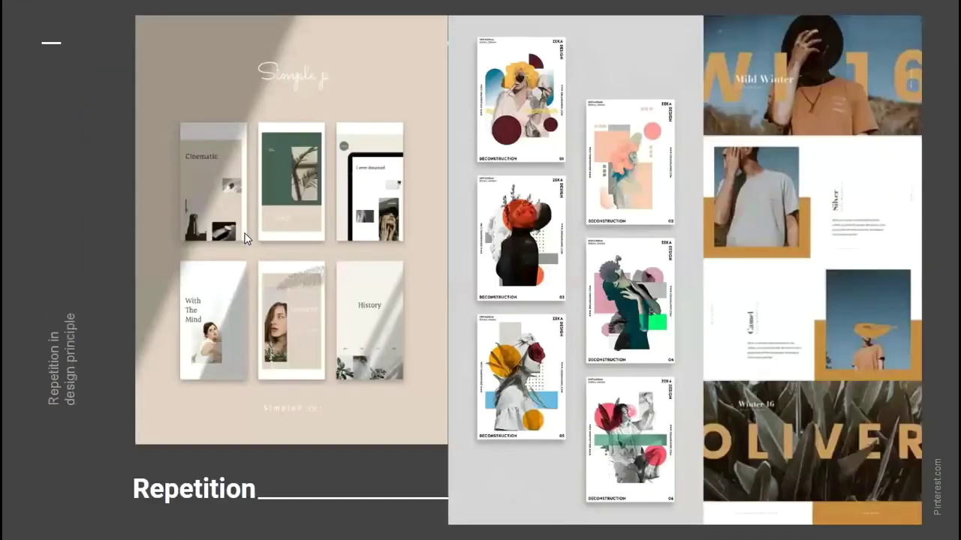
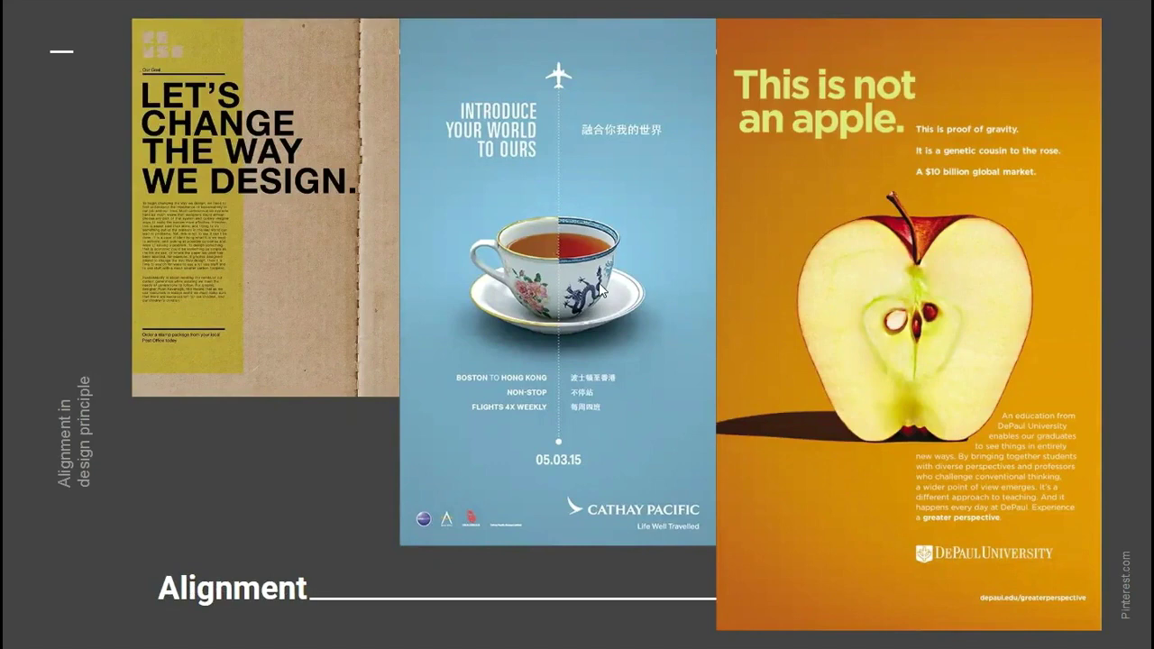
of Graphic Design
Fundamental |
Principles
Composition
Layout
Contrast
Repetition
Alignment

Slide 11
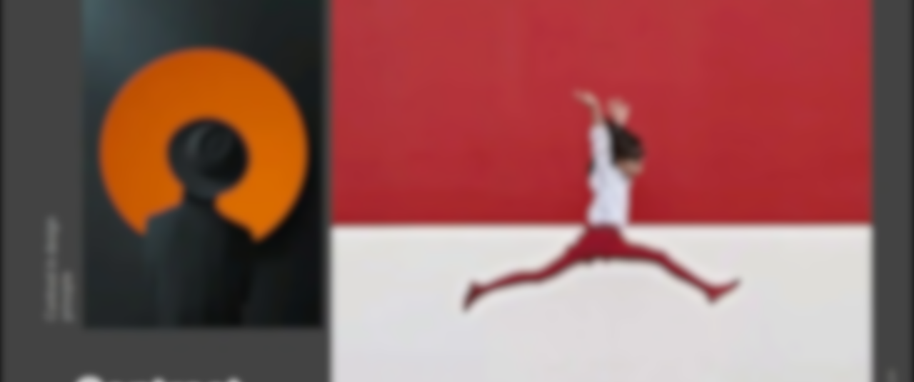
Principles
Contrast in
Design principle
Contrast
Repetition
Alignment

Slide 12
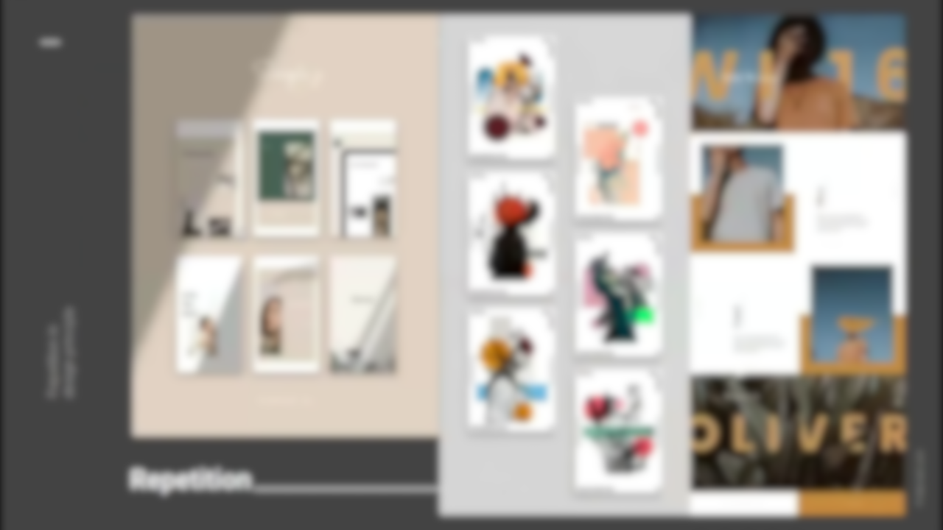
Principles
Contrast in
Design principle
Repetition in
Design principle
Contrast
Repetition
Alignment

Slide 13
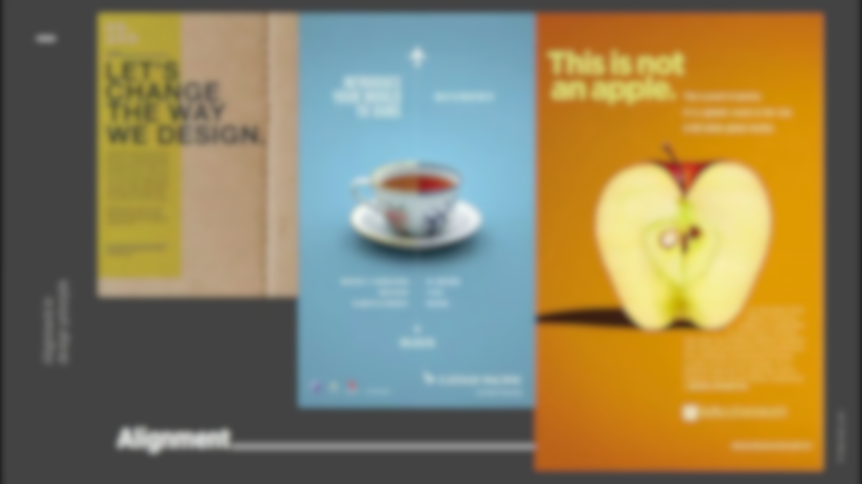
Principles
Repetition in
Design principle
Repetition
Alignment

Slide 14
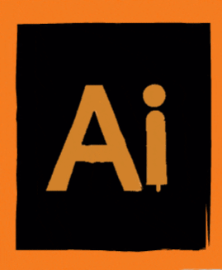
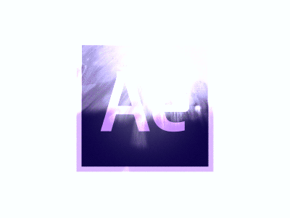
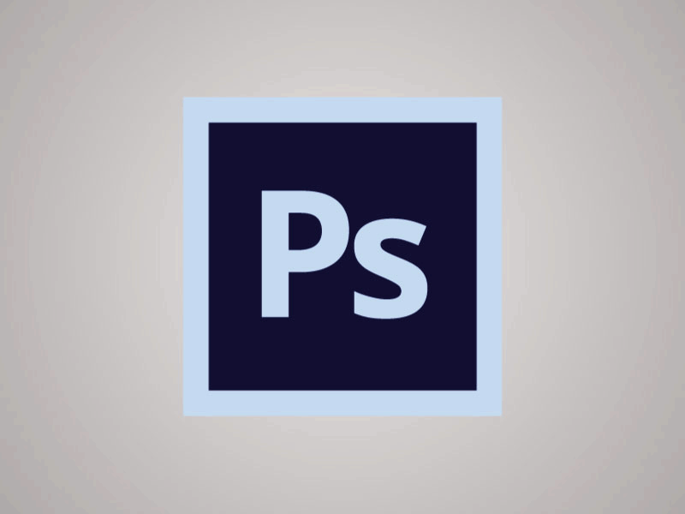
Tools & Software
Adobe Photoshop
Adobe Illustrator
Adobe InDesign
FreeHand
Adobe XD
Adobe After Effect

Slide 15


Slide 16


Slide 17
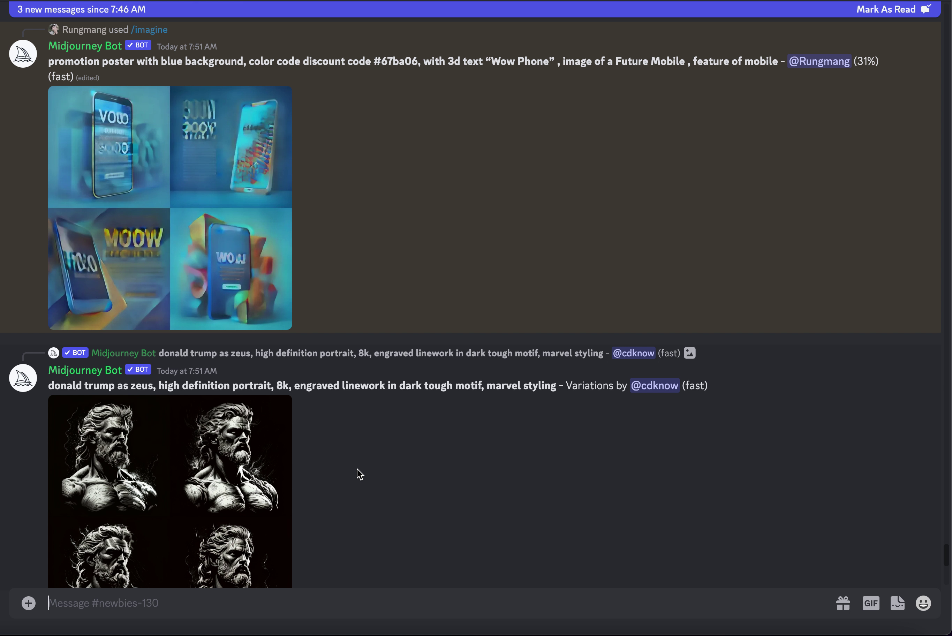

Slide 18
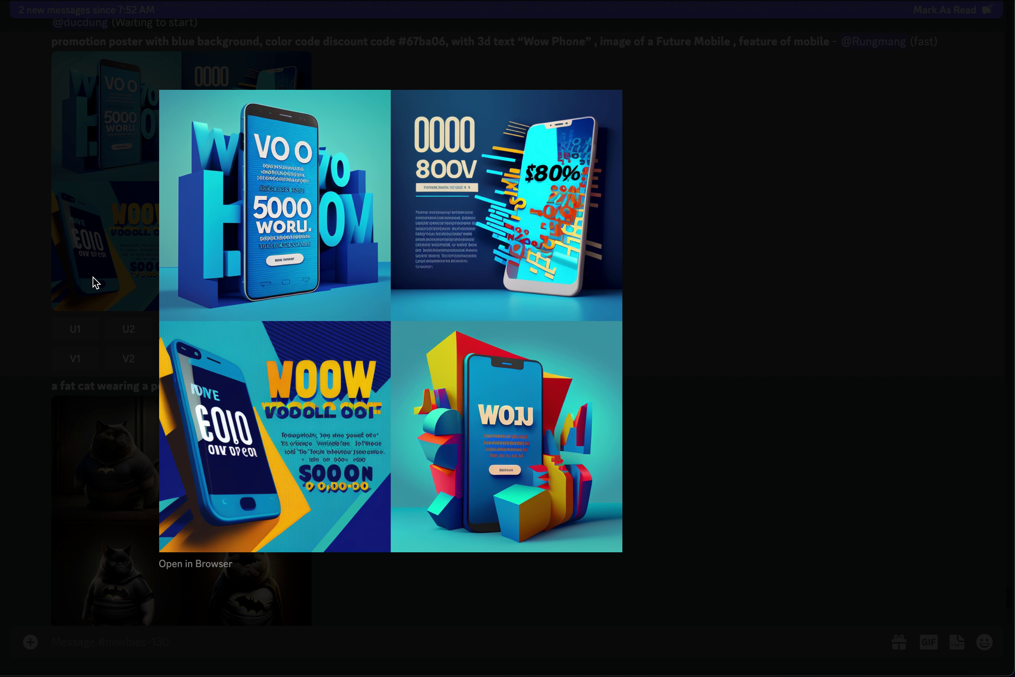

Slide 19

THANKS!
Do you have any questions?
-Romiya Dangol

